Slide 1
Self Advocacy
How to be your own best advocate

Slide 2
Why is advocacy important?
Getting your wants and needs met
Getting the most out of your child’s educational services or adult services
Let’s others know more about you and/or your child; creates relationships
Empowerment; knowing is power
Protection of Rights

Slide 3
Parents Share Their Stories

Slide 4
Why is your voice powerful?
This is your life (self advocate)
He or She is YOUR child
You know your child best
You have the history of what has worked and what hasn’t worked in the past

Slide 5
Making a Strong Voice Stronger
Advocacy Plan:
Effective communication
Problem solving
Decision Making
Self Determination and supported decision making

Slide 6
Know Your Rights
Knowledge is power
Let them know you know

Slide 7
Know Your wants!
How do you see your child’s life in the next year, two years, five years, ten years, etc.???
How do they see their life in the future?
My life now; my life in the future

Slide 8
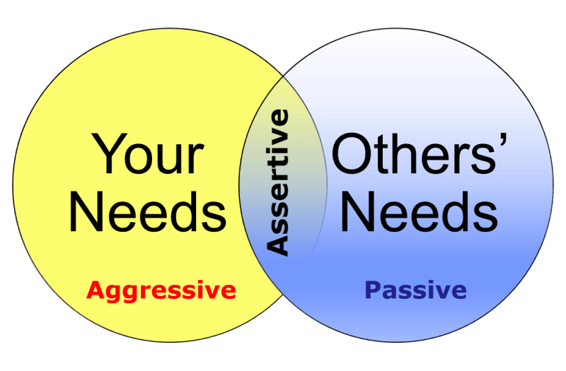
Communication
Assertive
Passive
Aggressive
Passive aggressive

Slide 9
Problem Solving
Break it down into steps
What is my problem?
What needs to change?
What ideas do I have to change it?
Who do I need to help me?
Keep a record of past attempts: what has worked, what hasn’t
Be open to other ideas
Create a working relationship if possible
Be a part of the solution but not the only part

Slide 10
Decision Making
Self determination
Allow son or daughter to explore their own ideas
Allow for risk taking – safely
Encourage self confidence
Let your child see the value of his/her difference
Recognize their efforts on the process of reaching goals
Set realistic expectations – but encourage growth
Allow child to take responsibility
Provide honest feedback

Slide 11
Supported Decision Making
Person Centered:
Always ask the person what they want
Everyone has the right to make choices
People will make good choices for themselves with the right support. Who can you have help?
Remember: We all need help with decisions at one point or another

Slide 12
Advocacy Plan
PUT THIS IN WRITING FOR YOURSELF and ALL PARTIES
What is goal?
Who will help?
Timelines?
Set smaller goals to ensure the bigger picture is being realized
Celebrate achievements – even the smallest.
Remember: Confidence!!

